Slide 1

Memcomb
Noah Bradley, Bryce Waters, Isaac Watson, Jizhou Zhang, Andrew Dever, Kyle King

Slide 2
Memcomb
For those who want to share and connect through similar memories in their lives. The Memcomb application is a social media platform that allows users to upload photos, videos, and audio, with an attached caption, that displays an important event in their lives. Unlike similar applications, Memcomb will connect users who share events of a similar time and place, allowing those users to discover each other. Our product provides a new way for users to interact with one another.

Slide 3
Last Week and Next Sprint
Meetings with the group and the professor to understand project requirements
Decision to switch from a mobile Android app to a web app
Created wireframes for UI design
Developed login system, created Splash HTML pages from design
Fixing our repo issues
Research timeline
Draw database schema
Add views for: timeline, account management, etc.
Implement test cases

Slide 4
Next Sprint Continued
Registration
Login/Logout
Role assignment and Access control rules
Password modification / Forgotten functionality
Email verification o User management (Creation / Deletion / Update / Search)

Slide 5
Challenges and Risks
Errors with Visual Studio were happening for members running project after cloning them off of Github repository but not for the original creator of the project
Some members were not getting the latest updates from the master branch in their own branches

Slide 6
Mitigation Plan
Conduct research to resolve the software version control errors preventing several group members from running the cloned project
Promptly notifying other group members if we encounter an error while running the project as well as assisting group members who are experiencing an error

Slide 7
User Stories
“As a user I need to be able to login with my own account so that I can post content about the places I have been in order to connect with other users”
“As a user I need to be able to tag a location along with date and time to my content in order to connect with other users who were at the same place at the same date and time”

Slide 8
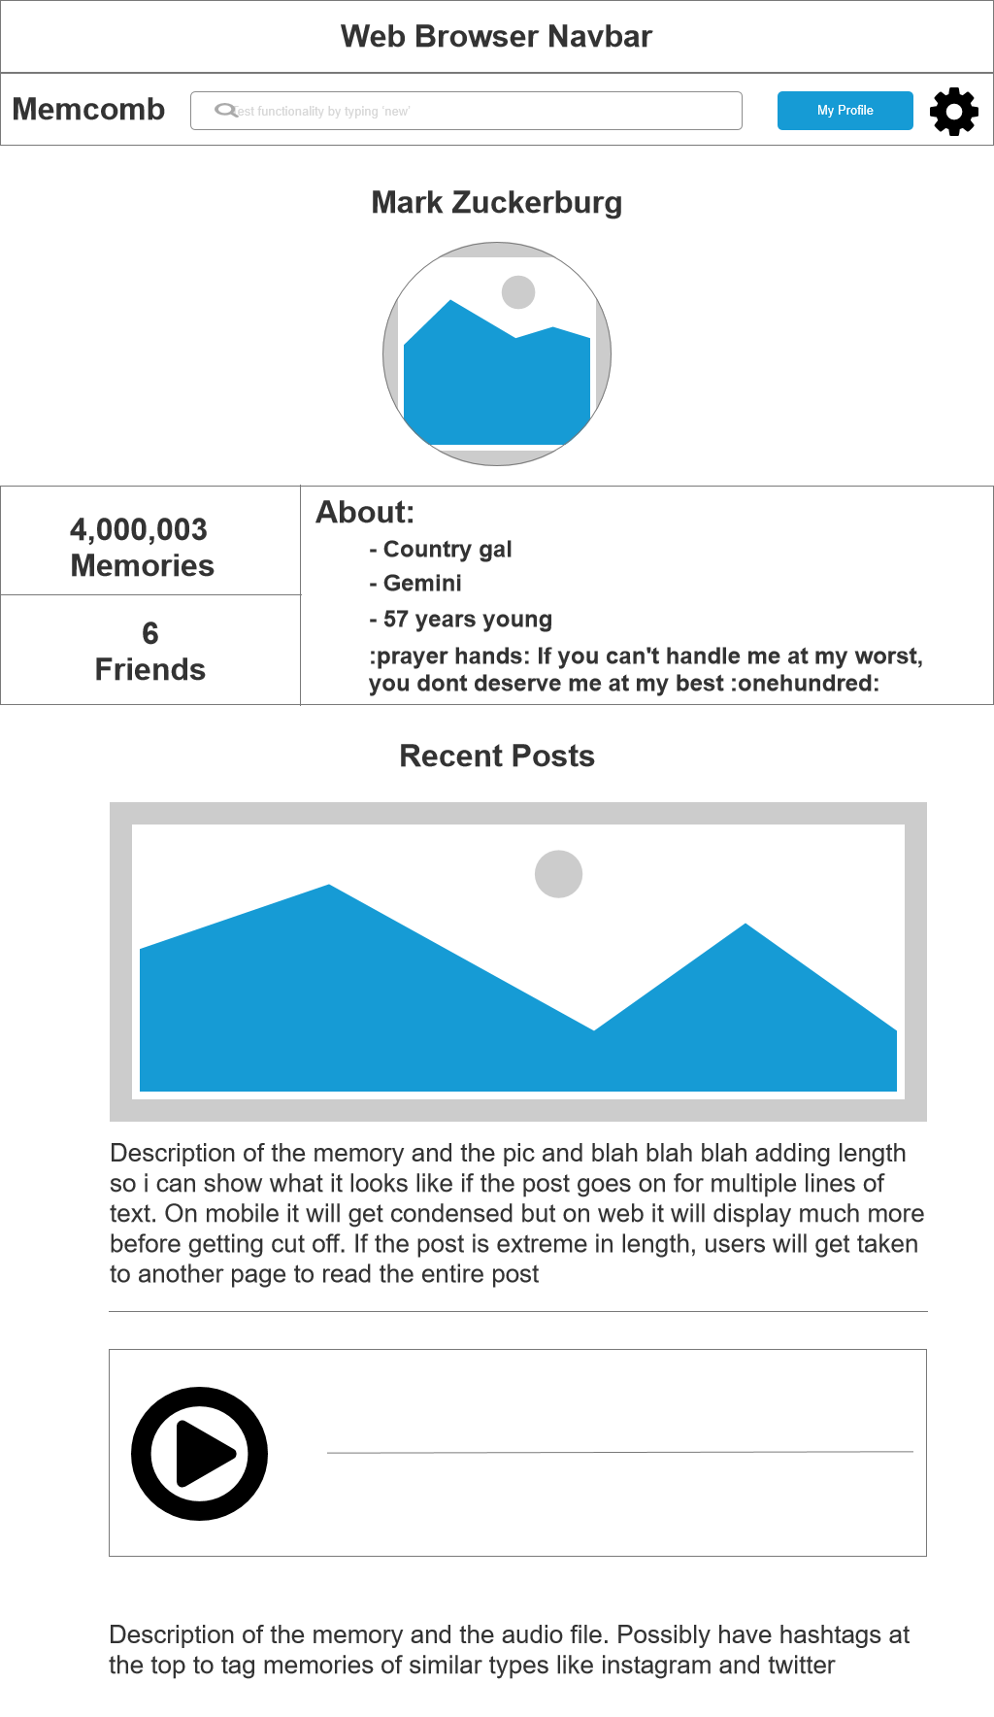
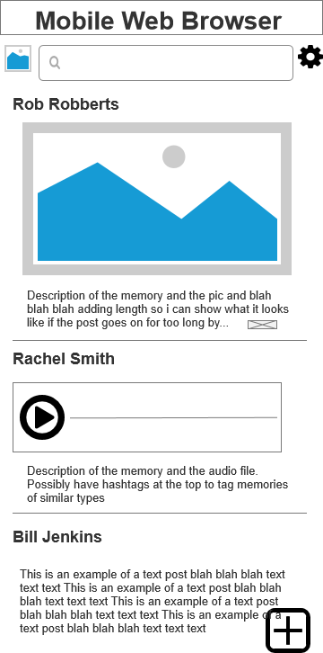
Wireframes

Slide 9
QA Tests
A User can not create a username/email/password longer than 50 characters
A User can not create a pre-existing username/email
A User must create a password with at least one capital letter and two digits
A User can only enter in 10 consecutive digits as a phone number, with no added characters
Subject to change

Slide 10
Updated: Tools, languages, servers
ASP.Net mvc web application
C#, HTML, CSS
mySQL
GitHub
GroupMe
Discord
Google Drive
Trello
Axure

